Slide 1
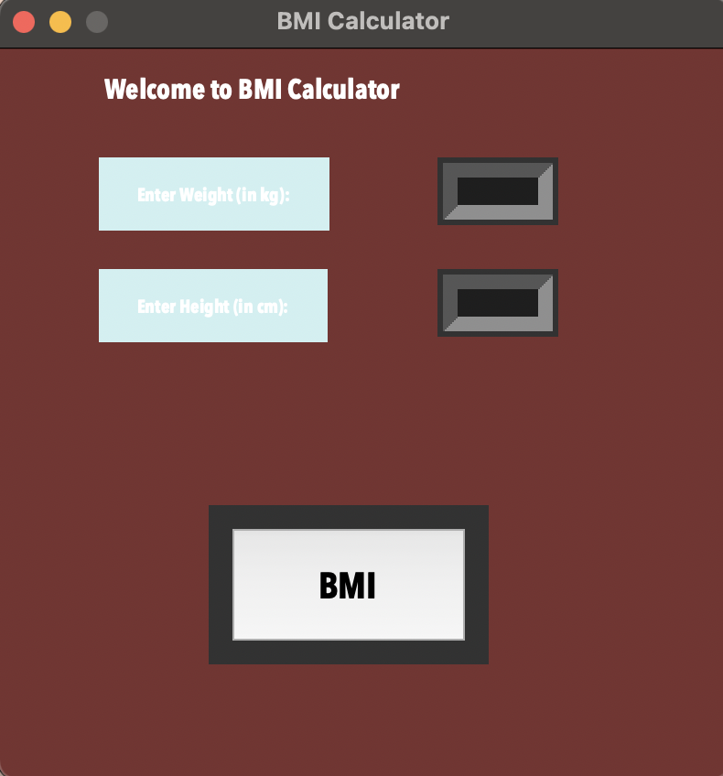
BMI Calculator
body mass index
Users can calculate their body mass index using this tool and depending on your number you will be told whether you are underweight, normal/healthy, overweight, or obese.
Brittney Ochoa
Original coder: https://github.com/NILESH8757/BMI-Calculator/blob/master/bmi_calculator.py

